Slide 1
Problem-01:
Given a circle C with radius 10 and center coordinates (1, 4). Apply the translation with distance 5 towards X axis and 1 towards Y axis. Obtain the new coordinates of C without changing its radius.

Slide 2
Solution
Given-
Old center coordinates of C = (X_{old}, Y_{old}) = (1, 4)
Translation vector = (T_{x}, T_{y}) = (5, 1)
Let the new center coordinates of C = (X_{new}, Y_{new}).
Applying the translation equations, we have-
X_{new} = X_{old} + T_{x} = 1 + 5 = 6
Y_{new} = Y_{old} + T_{y} = 4 + 1 = 5
Thus, New center coordinates of C = (6, 5).

Slide 3
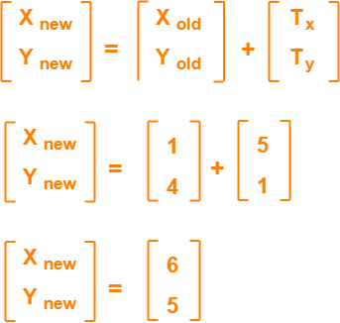
In matrix form, the new center coordinates of C after translation may be obtained as
Thus, New center coordinates of C = (6, 5).

Slide 4
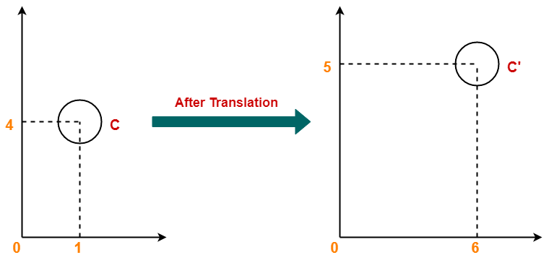

Slide 5
Problem-02:
Given a square with coordinate points A(0, 3), B(3, 3), C(3, 0), D(0, 0). Apply the translation with distance 1 towards X axis and 1 towards Y axis. Obtain the new coordinates of the square.

Slide 6
Solution
Given- Old coordinates of the square = A (0, 3), B(3, 3), C(3, 0), D(0, 0)
Translation vector = (T_{x}, T_{y}) = (1, 1)
For Coordinates A(0, 3)
Let the new coordinates of corner A = (X_{new}, Y_{new}).
Applying the translation equations, we have-
X_{new} = X_{old} + T_{x} = 0 + 1 = 1
Y_{new} = Y_{old} + T_{y} = 3 + 1 = 4
Thus, New coordinates of corner A = (1, 4).

Slide 7
For Coordinates B(3, 3)
Let the new coordinates of corner B = (X_{new}, Y_{new}).
Applying the translation equations, we have-
X_{new} = X_{old} + T_{x} = 3 + 1 = 4
Y_{new} = Y_{old} + T_{y} = 3 + 1 = 4
Thus, New coordinates of corner B = (4, 4).

Slide 8
For Coordinates C(3, 0)
Let the new coordinates of corner C = (X_{new}, Y_{new}).
Applying the translation equations, we have-
X_{new} = X_{old} + T_{x} = 3 + 1 = 4
Y_{new} = Y_{old} + T_{y} = 0 + 1 = 1
Thus, New coordinates of corner C = (4, 1).

Slide 9
For Coordinates D(0, 0)
Let the new coordinates of corner D = (X_{new}, Y_{new}).
Applying the translation equations, we have-
X_{new} = X_{old} + T_{x} = 0 + 1 = 1
Y_{new} = Y_{old} + T_{y} = 0 + 1 = 1
Thus, New coordinates of corner D = (1, 1).

Slide 10
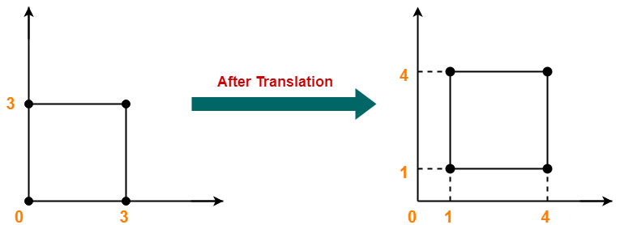

Slide 11
PRACTICE PROBLEMS BASED ON 2D ROTATION
Problem-01:
Given a line segment with starting point as (0, 0) and ending point as (4, 4). Apply 30 degree rotation anticlockwise direction on the line segment and find out the new coordinates of the line.

Slide 12
Solution-
We rotate a straight line by its end points with the same angle. Then, we re-draw a line between the new end points.
Given- Old ending coordinates of the line = (X_{old}, Y_{old}) = (4, 4)
Rotation angle = θ = 30º
Let new ending coordinates of the line after rotation = (X_{new}, Y_{new}).

Slide 13
X_{new}
= X_{old} x cosθ – Y_{old} x sinθ
= 4 x cos30º – 4 x sin30º
= 4 x (√3 / 2) – 4 x (1 / 2)
= 2√3 – 2
= 2(√3 – 1)
= 2(1.73 – 1)
= 1.46
Y_{new}
= X_{old} x sinθ + Y_{old} x cosθ
= 4 x sin30º + 4 x cos30º
= 4 x (1 / 2) + 4 x (√3 / 2)
= 2 + 2√3
= 2(1 + √3)
= 2(1 + 1.73)
= 5.46
Thus, New ending coordinates of the line after rotation = (1.46, 5.46).

Slide 14
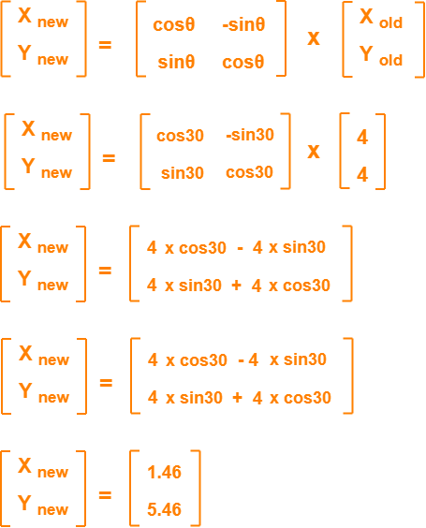
In matrix form, the new ending coordinates of the line after rotation may be obtained as

Slide 15
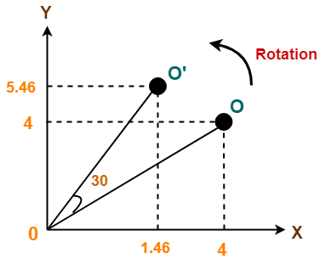
Thus, New ending coordinates of the line after rotation = (1.46, 5.46).

Slide 16
Problem-02:
Given a triangle with corner coordinates (0, 0), (1, 0) and (1, 1). Rotate the triangle by 90 degree anticlockwise direction and find out the new coordinates.
Solution-
We rotate a polygon by rotating each vertex of it with the same rotation angle.
Given-
Old corner coordinates of the triangle = A (0, 0), B(1, 0), C(1, 1)
Rotation angle = θ = 90º

Slide 17
For Coordinates A(0, 0)
Let the new coordinates of corner A after rotation = (X_{new}, Y_{new}).
Applying the rotation equations, we have-
X_{new}
= X_{old} x cosθ – Y_{old} x sinθ
= 0 x cos90º – 0 x sin90º
= 0
Y_{new}
= X_{old} x sinθ + Y_{old} x cosθ
= 0 x sin90º + 0 x cos90º
= 0
Thus, New coordinates of corner A after rotation = (0, 0).

Slide 18
For Coordinates B(1, 0)
Let the new coordinates of corner B after rotation = (X_{new}, Y_{new}).
X_{new}
= X_{old} x cosθ – Y_{old} x sinθ
= 1 x cos90º – 0 x sin90º
= 0
Y_{new}
= X_{old} x sinθ + Y_{old} x cosθ
= 1 x sin90º + 0 x cos90º
= 1 + 0
= 1
Thus, New coordinates of corner B after rotation = (0, 1).

Slide 19
For Coordinates C(1, 1)
Let the new coordinates of corner C after rotation = (X_{new}, Y_{new}).
X_{new}
= X_{old} x cosθ – Y_{old} x sinθ
= 1 x cos90º – 1 x sin90º
= 0 – 1
= -1
Y_{new}
= X_{old} x sinθ + Y_{old} x cosθ
= 1 x sin90º + 1 x cos90º
= 1 + 0
= 1
Thus, New coordinates of corner C after rotation = (-1, 1).

Slide 20
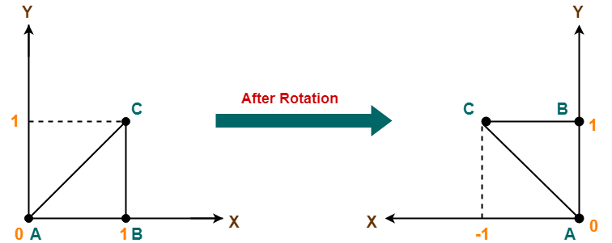
Thus, New coordinates of the triangle after rotation
A (0, 0), B(0, 1), C(-1, 1).

Slide 21
PRACTICE PROBLEMS BASED ON 2D SCALING
Problem-01:
Given a square object with coordinate points A(0, 3), B(3, 3), C(3, 0), D(0, 0). Apply the scaling parameter 2 towards X axis and 3 towards Y axis and obtain the new coordinates of the object.
Solution-
Given - Old corner coordinates of the square = A (0, 3), B(3, 3), C(3, 0), D(0, 0)
Scaling factor along X axis = 2
Scaling factor along Y axis = 3

Slide 22
For Coordinates A(0, 3)
Let the new coordinates of corner A after scaling = (X_{new}, Y_{new}).
Applying the scaling equations, we have-
X_{new} = X_{old} x S_{x} = 0 x 2 = 0
Y_{new} = Y_{old} x S_{y} = 3 x 3 = 9
Thus, New coordinates of corner A after scaling = (0, 9).

Slide 23
For Coordinates B(3, 3)
Let the new coordinates of corner B after scaling = (X_{new}, Y_{new}).
Applying the scaling equations, we have-
X_{new} = X_{old} x S_{x} = 3 x 2 = 6
Y_{new} = Y_{old} x S_{y} = 3 x 3 = 9
Thus, New coordinates of corner B after scaling = (6, 9).

Slide 24
For Coordinates C(3, 0)
Let the new coordinates of corner C after scaling = (X_{new}, Y_{new}).
Applying the scaling equations, we have-
X_{new} = X_{old} x S_{x} = 3 x 2 = 6
Y_{new} = Y_{old} x S_{y} = 0 x 3 = 0
Thus, New coordinates of corner C after scaling = (6, 0).

Slide 25
For Coordinates D(0, 0)
Let the new coordinates of corner D after scaling = (X_{new}, Y_{new}).
Applying the scaling equations, we have-
X_{new} = X_{old} x S_{x} = 0 x 2 = 0
Y_{new} = Y_{old} x S_{y} = 0 x 3 = 0
Thus, New coordinates of corner D after scaling = (0, 0).

Slide 26
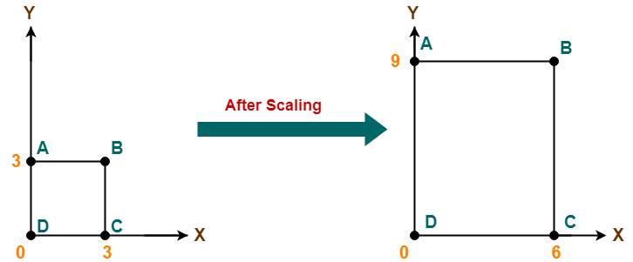
Thus, New coordinates of the square after scaling = A (0, 9), B(6, 9), C(6, 0), D(0, 0).

Slide 27
PRACTICE PROBLEMS BASED ON 2D REFLECTION
Problem-01:
Given a triangle with coordinate points A(3, 4), B(6, 4), C(5, 6). Apply the reflection on the X axis and obtain the new coordinates of the object.
Solution-
Given- Old corner coordinates of the triangle = A (3, 4), B(6, 4), C(5, 6)
Reflection has to be taken on the X axis

Slide 28
For Coordinates A(3, 4)
Let the new coordinates of corner A after reflection = (X_{new}, Y_{new}).
Applying the reflection equations, we have-
X_{new} = X_{old} = 3
Y_{new} = -Y_{old} = -4
Thus, New coordinates of corner A after reflection = (3, -4).

Slide 29
For Coordinates B(6, 4)
Let the new coordinates of corner B after reflection = (X_{new}, Y_{new}).
Applying the reflection equations, we have-
X_{new} = X_{old} = 6
Y_{new} = -Y_{old} = -4
Thus, New coordinates of corner B after reflection = (6, -4).

Slide 30
For Coordinates C(5, 6)
Let the new coordinates of corner C after reflection = (X_{new}, Y_{new}).
Applying the reflection equations, we have-
X_{new} = X_{old} = 5
Y_{new} = -Y_{old} = -6
Thus, New coordinates of corner C after reflection = (5, -6).

Slide 31
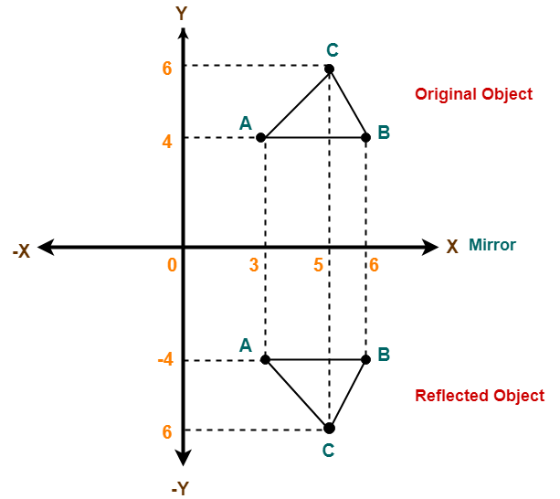
Thus, New coordinates of the triangle after reflection = A (3, -4), B(6, -4), C(5, -6).

Slide 32
Problem-02:
Given a triangle with coordinate points A(3, 4), B(6, 4), C(5, 6). Apply the reflection on the Y axis and obtain the new coordinates of the object.
Solution-
Given- Old corner coordinates of the triangle = A (3, 4), B(6, 4), C(5, 6)
Reflection has to be taken on the Y axis

Slide 33
For Coordinates A(3, 4)
Let the new coordinates of corner A after reflection = (X_{new}, Y_{new}).
Applying the reflection equations, we have-
X_{new} = -X_{old} = -3
Y_{new} = Y_{old} = 4
Thus, New coordinates of corner A after reflection = (-3, 4).

Slide 34
For Coordinates B(6, 4)
Let the new coordinates of corner B after reflection = (X_{new}, Y_{new}).
Applying the reflection equations, we have-
X_{new} = -X_{old} = -6
Y_{new} = Y_{old} = 4
Thus, New coordinates of corner B after reflection = (-6, 4).

Slide 35
For Coordinates C(5, 6)
Let the new coordinates of corner C after reflection = (X_{new}, Y_{new}).
Applying the reflection equations, we have-
X_{new} = -X_{old} = -5
Y_{new} = Y_{old} = 6
Thus, New coordinates of corner C after reflection = (-5, 6).

Slide 36
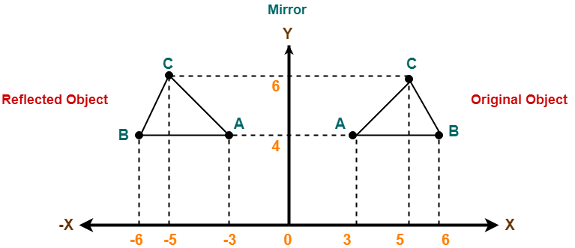
New coordinates of the triangle after reflection = A (-3, 4), B(-6, 4), C(-5, 6).

Slide 37
PRACTICE PROBLEMS BASED ON 2D SHEARING
Problem-01:
Given a triangle with points (1, 1), (0, 0) and (1, 0). Apply shear parameter 2 on X axis and 2 on Y axis and find out the new coordinates of the object.
Solution-
Given-
Old corner coordinates of the triangle = A (1, 1), B(0, 0), C(1, 0)
Shearing parameter towards X direction (Sh_{x}) = 2
Shearing parameter towards Y direction (Sh_{y}) = 2

Slide 38
Shearing in X Axis-
For Coordinates A(1, 1)
Let the new coordinates of corner A after shearing = (X_{new}, Y_{new}).
Applying the shearing equations, we have-
X_{new} = X_{old} + Sh_{x} x Y_{old} = 1 + 2 x 1 = 3
Y_{new} = Y_{old} = 1
Thus, New coordinates of corner A after shearing = (3, 1).

Slide 39
For Coordinates B(0, 0)
Let the new coordinates of corner B after shearing = (X_{new}, Y_{new}).
Applying the shearing equations, we have-
X_{new} = X_{old} + Sh_{x} x Y_{old} = 0 + 2 x 0 = 0
Y_{new} = Y_{old} = 0
Thus, New coordinates of corner B after shearing = (0, 0).

Slide 40
For Coordinates C(1, 0)
Let the new coordinates of corner C after shearing = (X_{new}, Y_{new}).
Applying the shearing equations, we have-
X_{new} = X_{old} + Sh_{x} x Y_{old} = 1 + 2 x 0 = 1
Y_{new} = Y_{old} = 0
Thus, New coordinates of corner C after shearing = (1, 0).
Thus, New coordinates of the triangle after shearing in X axis = A (3, 1), B(0, 0), C(1, 0).

Slide 41
Shearing in Y Axis-
For Coordinates A(1, 1)
Let the new coordinates of corner A after shearing = (X_{new}, Y_{new}).
Applying the shearing equations, we have-
X_{new} = X_{old} = 1
Y_{new} = Y_{old} + Sh_{y} x X_{old} = 1 + 2 x 1 = 3
Thus, New coordinates of corner A after shearing = (1, 3).

Slide 42
For Coordinates B(0, 0)
Let the new coordinates of corner B after shearing = (X_{new}, Y_{new}).
Applying the shearing equations, we have-
X_{new} = X_{old} = 0
Y_{new} = Y_{old} + Sh_{y} x X_{old} = 0 + 2 x 0 = 0
Thus, New coordinates of corner B after shearing = (0, 0).

Slide 43
For Coordinates C(1, 0)
Let the new coordinates of corner C after shearing = (X_{new}, Y_{new}).
Applying the shearing equations, we have-
X_{new} = X_{old} = 1
Y_{new} = Y_{old} + Sh_{y} x X_{old} = 0 + 2 x 1 = 2
Thus, New coordinates of corner C after shearing = (1, 2).
Thus, New coordinates of the triangle after shearing in Y axis = A (1, 3), B(0, 0), C(1, 2).

Slide 44
